Slide 1
IEOM® Society’s core purpose is to globally foster critical thinking and its effective utilizations in the field of Industrial Engineering (IE) and Operations Management (OM) by providing means to communicate and network among diversified people motivated by similar interests.
®
IEOM Society International is a 501(c)(3) nonprofit professional organization
Diversity is the key to our success.
www.ieomsociety.org

Slide 2
Activities
Association Services – Membership and Fellows
IEOM Professional and Student Chapters
IEOM Conferences – USA, EU, Asia, Africa and South America
IEOM Journal(s)
Forums:
Global Engineering Education Forum
Industry Solutions Forum
Women in Industry and Academia Forum
Certification – LSS, FMEA, GD&T
Awards
Newsletters
IEOM Global Council
www.ieomsociety.org

Slide 3
Trademarks with USPTO
IEOM®
IEOM Society™
IEOM logo
International Conference on Industrial Engineering and Operations Management®
Are registered with the U.S. Patent and Trademark Office (USPTO) as the trademarks of the IEOM Society.
www.ieomsociety.org

Slide 4
IEOM Global Council
Regional Council Members
Asia - Dr. Abdul Talib Bon, Universiti Tun Hussein Onn Malaysia
Africa - Dr. Charles Mbohwa, University of Johannesburg, South Africa
Caribbean and Central America – Dr. Eldon Caldwell, University of Costa Rica
Europe - Dr. Jose Arturo Garza-Reyes - University of Derby, UK
Middle East - Dr. Umar Al-Turki, King Fahd University of Petroleum and Minerals, Saudi Arabia
North America - Dr. Eui H. Park, North Carolina A&T State University, USA
South America –
At Large Members
Dr. Ilham Kissani, Al Akhawayn University, Ifrane, Morocco
Dr. Abu Masud, Wichita State University, Kansas, USA
Dr. Bernardo Villarreal, Universidad de Monterrey, Mexico
Advisors:
• Dr. Hamid Parsaei, Texas A&M
Executive Leadership
Dr. Ahad Ali – Executive Director
Professor Don Reimer – Director of Chapter Development
Dr. Mohammed Khadem – Program Director
www.ieomsociety.org

Slide 5
Conferences
International Conference
2010 – Dhaka
2011 – Kuala Lumpur
2012 – Istanbul
2014 – Bali
2015 – Dubai
2016 – Kuala Lumpur
2017 – Rabat
2018 – Bandung
2019 – Bangkok
USA/EU/Latin
2015 – Orlando
2016 – Detroit
2017 – UK
2017 – Bogota
2018 – Paris
2018 – Washington DC
2019 – Toronto
www.ieomsociety.org

Slide 6
IEOM Society International
UK
San Jose
Detroit 2016
Istanbul
2012
DC
Orlando 2015
Rabat2017
Xiang Tan
Seoul
Dhaka
2010
Dubai 2015
Bogota
KL 2011 2016
Bandung
Bali 2014
Rio
Johannesburg
Sydney

Slide 7
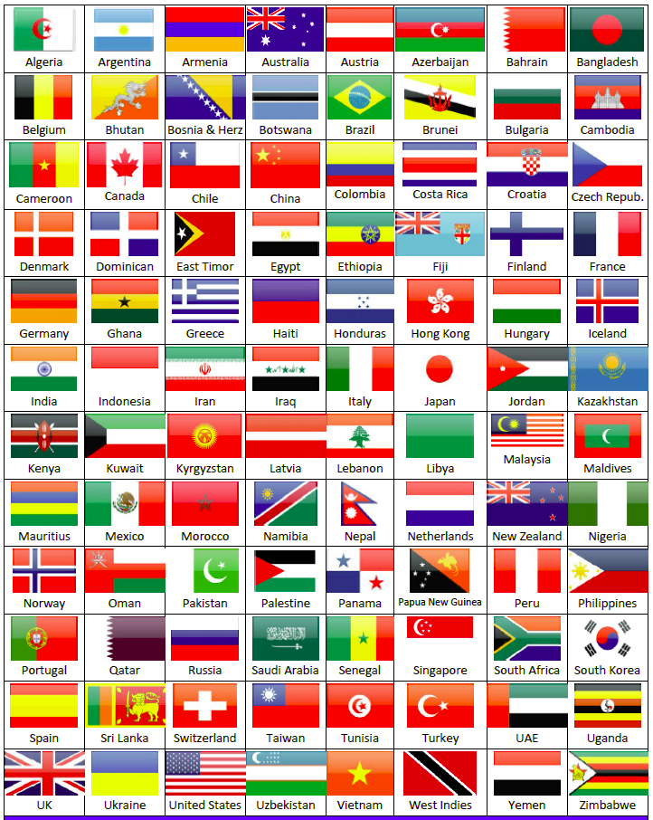
Chapters
Professional Chapters
Student Chapters
www.ieomsociety.org

Slide 8
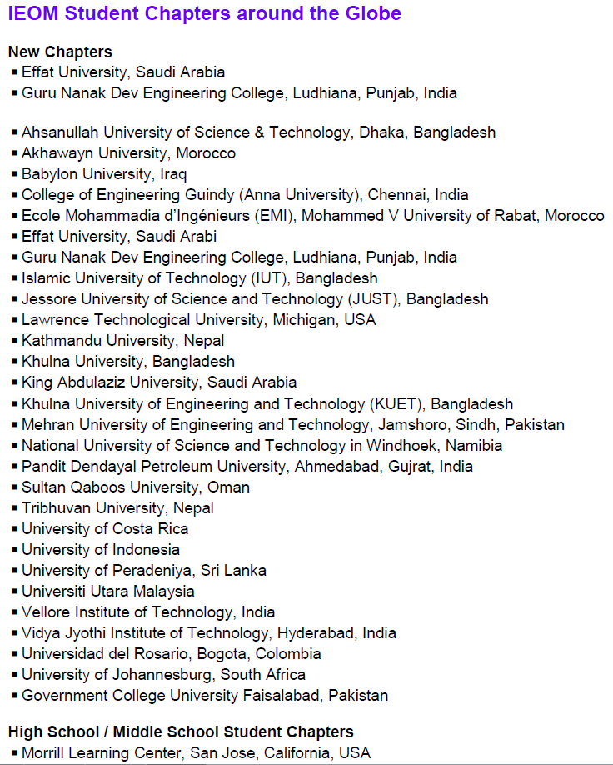

Slide 9
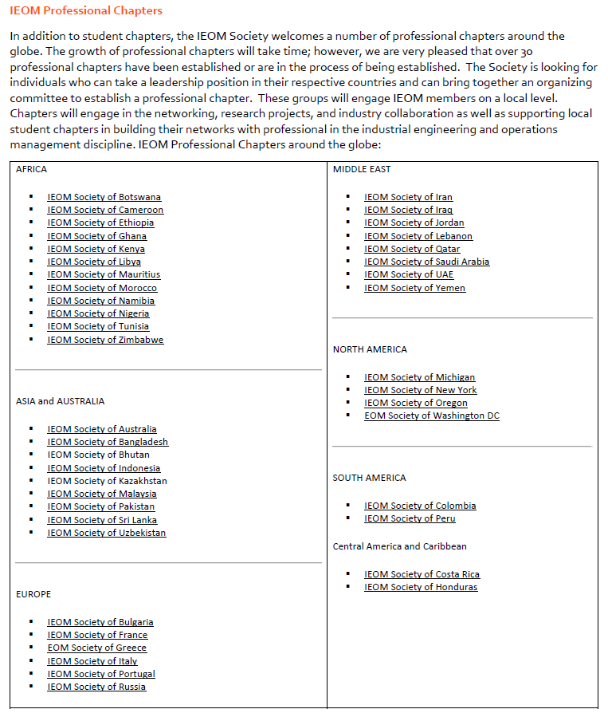

Slide 10
Competitions
IEOM Undergraduate Student Paper Competition Sponsored by SIEMENS
IEOM Graduate Student Paper Competition Sponsored by EATON Corporation
Doctoral Dissertation Competition
Final Year Project (FYP)/Senior Capstone Design Project Poster Competition
Undergraduate Research Competition
High School and Middle School (K-12) STEM Competition
Masters’ Thesis Competition
Simulation and PLM Competition
Best Poster Award Competition
www.ieomsociety.org

Slide 11
IEOM Publication
IJIEOM
Editor-in-Chief
Prof. Jose Arturo Garza-Reyes
Professor of Operations Management
Head of the Centre for Supply Chain Improvement
College of Business, Law and Social Sciences
The University of Derby
Derby, UK
Online Proceedings – Scopus Indexing
www.ieomsociety.org

Slide 12
Membership
Membership: Professional and Student
University partners
Corporate Partners
Organization Partners
www.ieomsociety.org

Slide 13
Awards
IEOM Fellows (Academy of IEOM Fellows)
IEOM Global Diversity Awards
IEOM Innovation Awards
IEOM Global Manufacturing Awards
IEOM STEM Awards
IEOM Distinguished Educator Awards
IEOM Distinguished Industry Awards
IEOM Distinguished Service Awards
IEOM Outstanding Researcher Awards
IEOM Outstanding Teaching Awards
IEOM Industry Solutions Awards
IEOM Global Engineering Education Awards
IEOM Woman in Industry and Academia (WIIA) Awards
Outstanding Service Awards
Outstanding Student Awards
www.ieomsociety.org

Slide 14
Forums
Global Engineering Education
Industry Solutions
Women in Industry and Academia (WIIA)
www.ieomsociety.org

Slide 15
Media
Newsletters
LinkedIn
Facebook Group
Website
www.ieomsociety.org

Slide 16
Technical Groups
Cyber Security
Data Analytics
Defense and Aerospace
Engineering Management
Entrepreneurship, Innovation and Sustainability
Healthcare Systems and Management
Human Factors and Ergonomics
Information Technology and Quality Assurance
Invertor Management and Production Planning
Lean Systems Manufacturing and Design
Operations Research and Operations Management
Project Management
Quality and Reliability
Simulation and Modeling
Six Sigma
Supply Chain and Logistics
Sustainability and Green Systems
Systems Engineering
Technology Management
Total Quality Management
Transportation and Construction Management
www.ieomsociety.org

Slide 17
Certification and Standards
Certification
Lean Six Sigma
FMEA
GD&T
IEOM
IEOM Standards – Industry Consortiums
www.ieomsociety.org

Slide 27
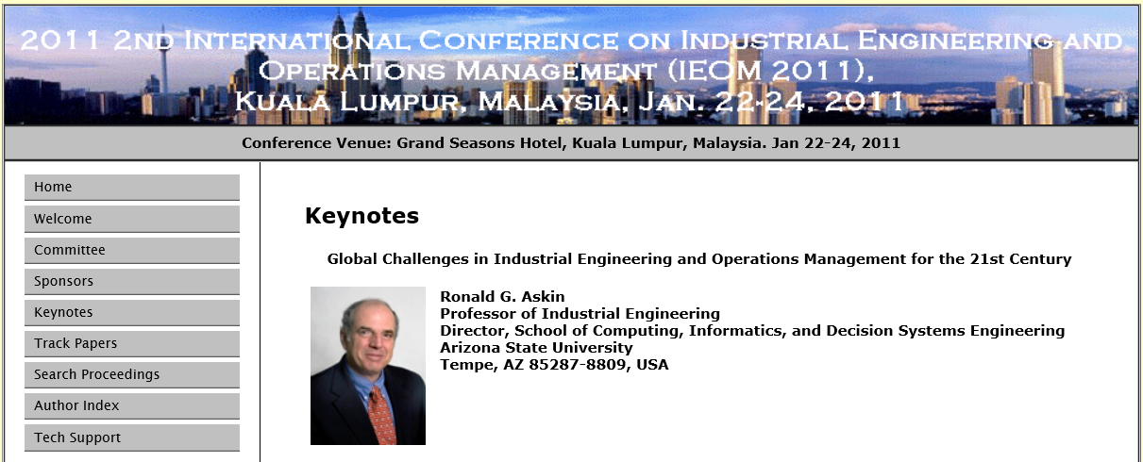
IEOM 2012 Malaysia
www.ieomsociety.org

Slide 28
IEOM 2010 Dhaka
www.ieomsociety.org

Slide 29
Establishing Your Professional Chapter
Hold an organizational meeting
Review and discuss the IEOM chapter organizational process
Complete and submit application to the IEOM Society.
Receive Charter Certificate from the IEOM Society
www.ieomsociety.org

Slide 30
Benefits
Establishing Your Professional Chapter
Leadership and Team Building
Communications
Organization Management
Skill Enhancement
IE & OM Tools and Techniques
Operations, process and systems improvement
Networking
Newsletters, webinar and social media groups
Free IEOM Email
Awards and recognition
www.ieomsociety.org

Slide 31
Suggested Chapter Activities
Monthly/bi-monthly meetings
Seminars and Workshops
Poster / Innovation Competitions
Guest Speakers
Attend and Participate in IEOM events
Access to IEOM Publications (Conferences, Journals, Presentations)
Picnic
Awards and Recognition
www.ieomsociety.org

Slide 32
Suggested IEOM CHAPTER OFFICERS
President
Vice President
Director of Operations
Director of Communications
Director of Finance
Director of Membership
Director of Programs
Director of Webmaster / Social Media
www.ieomsociety.org

Slide 33
THANK YOU
Contact Professor Don Reimer Director of Chapter Development
Email: info@ieomsociety.org

