Slide 1
®
Professor Don Reimer College Professor – Lawrence Tech University
Director of Chapter Development – IEOM Society International
Ahad Ali, Ph.D.
Associate Professor – Lawrence Tech University
Director, Industrial Engineering Programs
Director, Smart Manufacturing and Lean Systems Research Group
Executive Director - IEOM Society International
IEOM Society International, 21415 Civic Center Dr., Suite # 217, Southfield, Michigan 48076, USA
www.ieomsociety.org
IEOM Society International is a 501(c)(3) Nonprofit Professional Organization

Slide 2
IEOM Society’s mission is to foster critical thinking, innovation, and knowledge dissemination of Industrial Engineering (IE) and Operations Management (OM) among diversified people globally, especially in emerging countries.
®
www.ieomsociety.org

Slide 3
IEOM Chapter - Student Portfolio Development
Excellent Academic Record (GPA)
Software Skills and Certifications
IELTS / TOEFL / GRE
English Speaking / Project Presentation / Presentation Skill
Communications – written, oral and graphical
Student Organization Membership and involvement, student chapter officers, initiatives, etc.
Attend seminar, workshop, symposiums, etc.
Presentation at any events
Poster competition / innovation competition
Leading a team, organizing an event, team participation
Networking
Publications: Conference paper, journal paper, magazine article, newspaper article, etc.

Slide 4
IEOM Activities
Membership
IEOM Professional and Student Chapters
Conferences - USA, EU, Asia, Africa and South America
IEOM Journal - IJIEOM
Forums:
Global Engineering Education Forum
Industry Solutions Forum
Women in Industry and Academia Forum
Certification – LSS, FMEA, GD&T, FTA
Awards and Fellows
Newsletters
IEOM Global Council
www.ieomsociety.org

Slide 5
Trademarks with USPTO
IEOM®
IEOM Society™
IEOM logo
International Conference on Industrial Engineering and Operations Management®
Are registered with the U.S. Patent and Trademark Office (USPTO) as the trademarks of the IEOM Society.
www.ieomsociety.org

Slide 6
IEOM Global Council
Regional Council Members
Asia - Dr. Abdul Talib Bon, Universiti Tun Hussein Onn Malaysia
Africa - Dr. Charles Mbohwa, University of Johannesburg, South Africa
Caribbean and Central America – Dr. Eldon Caldwell, University of Costa Rica
Europe - Dr. Jose Arturo Garza-Reyes - University of Derby, UK
Middle East - Dr. Umar Al-Turki, King Fahd University of Petroleum & Minerals, Saudi Arabia
North America - Dr. Eui H. Park, North Carolina A&T State University, USA
South America –
At Large Members
Dr. Ilham Kissani, Al Akhawayn University, Ifrane, Morocco
Dr. Abu Masud, Wichita State University, Kansas, USA
Dr. Bernardo Villarreal, Universidad de Monterrey, Mexico
Advisors:
• Dr. Hamid Parsaei, Texas A&M
• Dr. Abdur Rahim, UNB
• Professor Don Reimer
www.ieomsociety.org

Slide 7
Conferences
Internat. Conference
2010 – Dhaka
2011 – Kuala Lumpur
2012 – Istanbul
2014 – Bali
2015 – Dubai
2016 – Kuala Lumpur
2017 – Rabat
2018 – Bandung
2019 – Bangkok
2020 – Dubai
2021 – Singapore
North America
2015 – Orlando
2016 – Detroit
2018 – DC
2019 – Toronto
2020 – Orlando
European (EU)
2017 – UK
2018 – Paris
2019 – Czech Republic
2020 – Italy
2021 – Portugal
South America
2017 – Bogota
2019 – Brazil
2020 – Costa Rica
2021 – Bogota
African Conference
2019 - Pretoria/Johannesburg
2021 – Marrakesh, Morocco
2023 – Cairo, Egypt
www.ieomsociety.org

Slide 8
IEOM Society International
UK
San Jose
Detroit 2016
Istanbul
2012
DC
Orlando 2015
Rabat2017
Xiang Tan
Seoul
Dhaka
2010
Dubai 2015
Bogota
KL 2011 2016
Bandung
Bali 2014
Rio
Johannesburg
Sydney

Slide 9
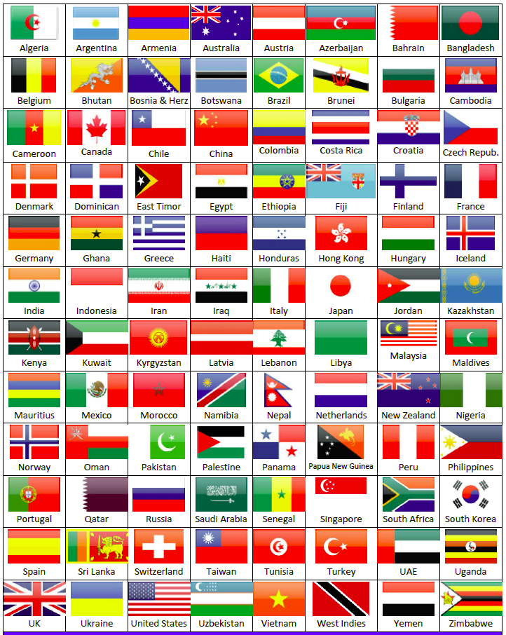
Chapters
Professional Chapters
Student Chapters
www.ieomsociety.org

Slide 10
IEOM Student Chapters
University of New Brunswick at Fredericton, Canada
Lawrence Technological University, Michigan, USA
Eastern Michigan University, USA
Central Connecticut State University, USA
King Abdulaziz University, Jeddah, Saudi Arabia
Effat University, Jeddah, Saudi Arabian
Sultan Qaboos University, Oman
Akhawayn University, Morocco
EMI, Rabat, Morocco
Zagazig University, Egypt
Morrill Learning Center, San Jose, USA
Lorraine University, Metz, France
University of Derby, UK
University of the Western of New England, UK
Qatar University
Sudan University of Science and Tech.
UTHM - Malaysia
University of Costa Rica
University of Indonesia
University of Johannesburg, South Africa

Slide 11
IEOM Student Chapters
Ahsanullah Univ. of Science & Technology, Dhaka, Bangladesh
Babylon University, Iraq
College of Engineering Guindy (Anna University), Chennai, India
Government College University Faisalabad, Pakistan
Guru Nanak Dev Engineering College, Punjab, India
Islamic University of Technology (IUT), Bangladesh
Jessore Univ.y of Science and Technology (JUST), Bangladesh
Kathmandu University, Nepal
Khulna Univ. of Engineering and Technology (KUET), Bangladesh
Khulna University, Bangladesh
Mehran Univ. of Eng. and Technology, Jamshoro, Sindh, Pakistan
Namibia Univ. of Science and Technology in Windhoek, Namibia
Pandit Dendayal Petroleum University, Ahmedabad, Gujrat, India
Tribhuvan University, Nepal
Universidad del Rosario, Bogota, Colombia
Universiti Utara Malaysia
University of Peradeniya, Sri Lanka
Vellore Institute of Technology, India
Vidya Jyothi Institute of Technology, Hyderabad, India
GCUF (Government College University Faisalabad)

Slide 12
IEOM Student Chapters
KFUPM
KSU
PSU
Al Faisal University
Dawood University of Engineering and Tech, Karachi, Pakistan
Fundación Universitaria Tecn Comfenalco, Bolívar, Colombia
LPU Laguna, Philippines
Sampoerna University, Jakarta, Indonesia
Technological Education Institute (TEI), Thessaly, Larissa, Greece
Technical University of Ambato, Ecuador
Kenyatta University, Nairobi, Kenya
University of Rosario, Bogota, Colombia
University of Quindio, Colombia
Universidad de San Buenaventura, Cali, Valle, Colombia
Universitas Sebelas Maret (UNS), Surakarta, Indonesia
University of Vaasa, Finland
University of West Bohemia, Pilsen, Czech Republic

Slide 13
IEOM Student Chapters
IEOM Society International

Slide 14
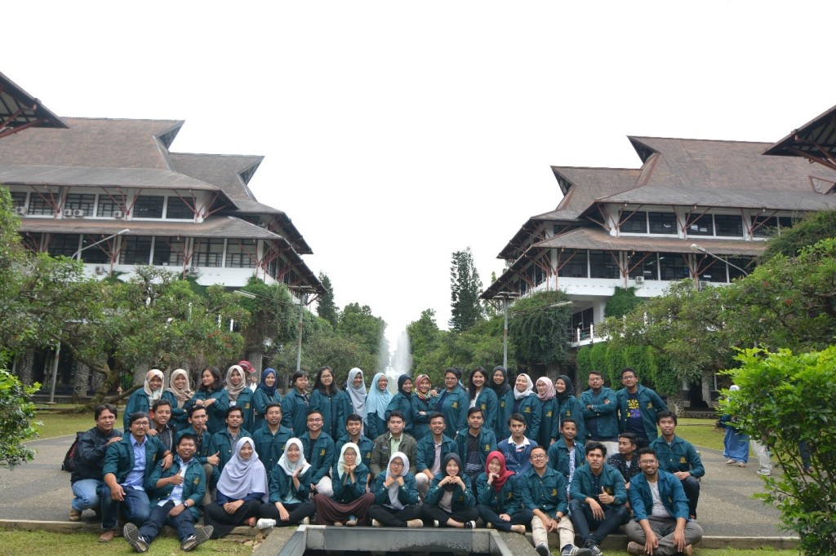
Institut Teknologi Bandung (ITB), Indonesia

Slide 15
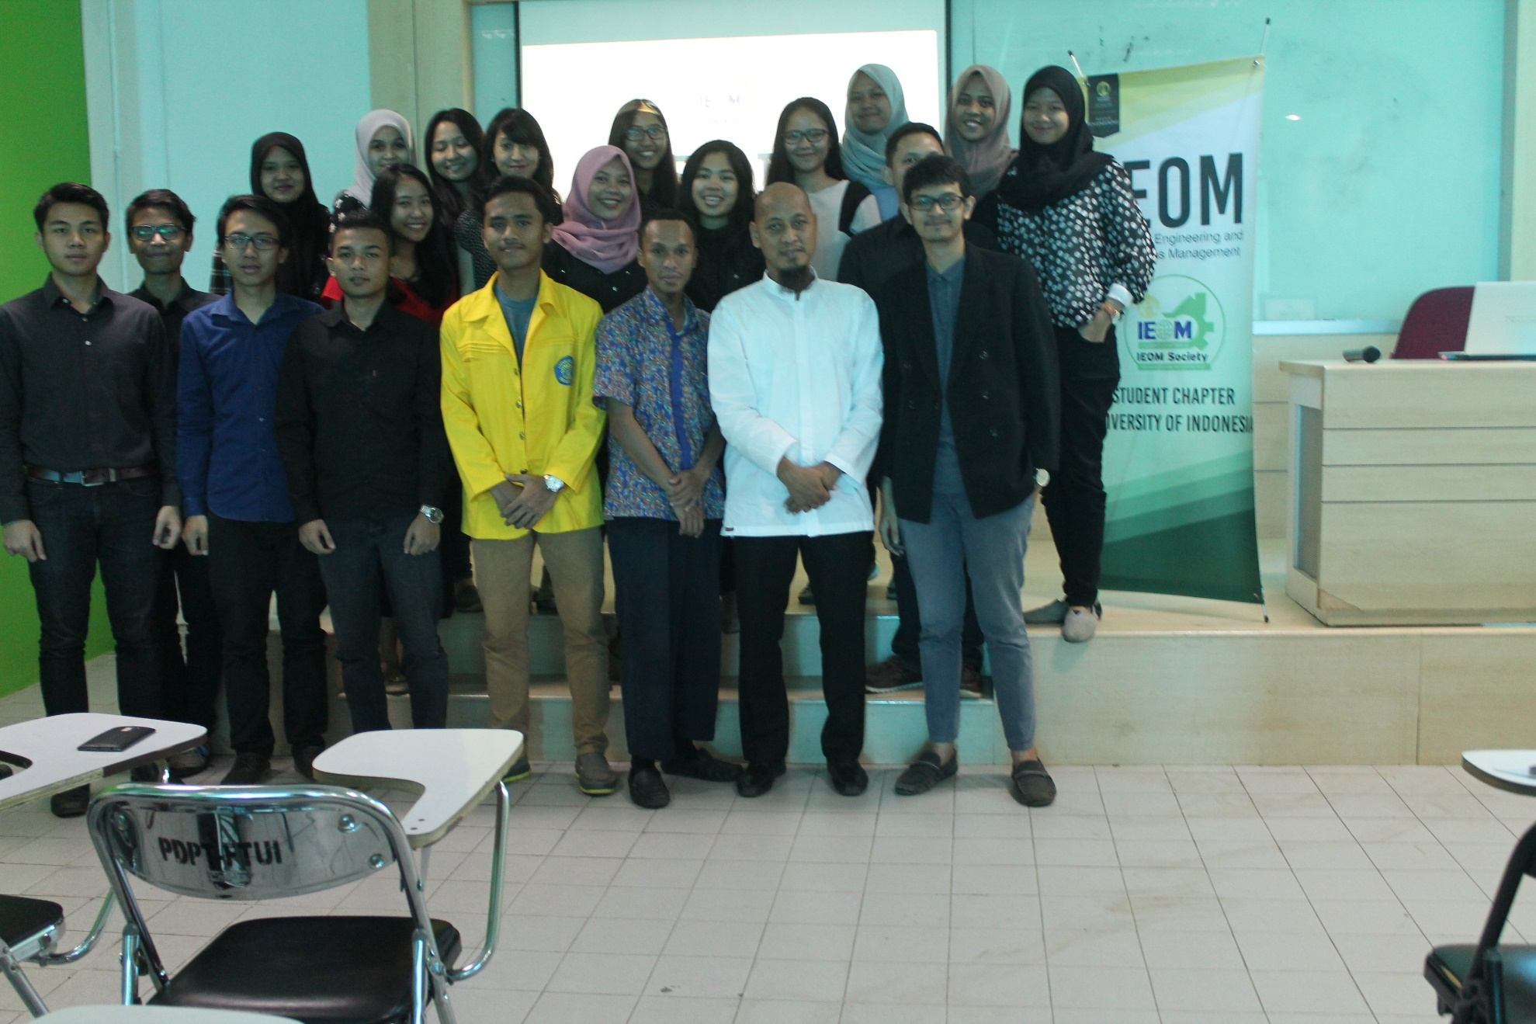
University of Indonesia

Slide 16
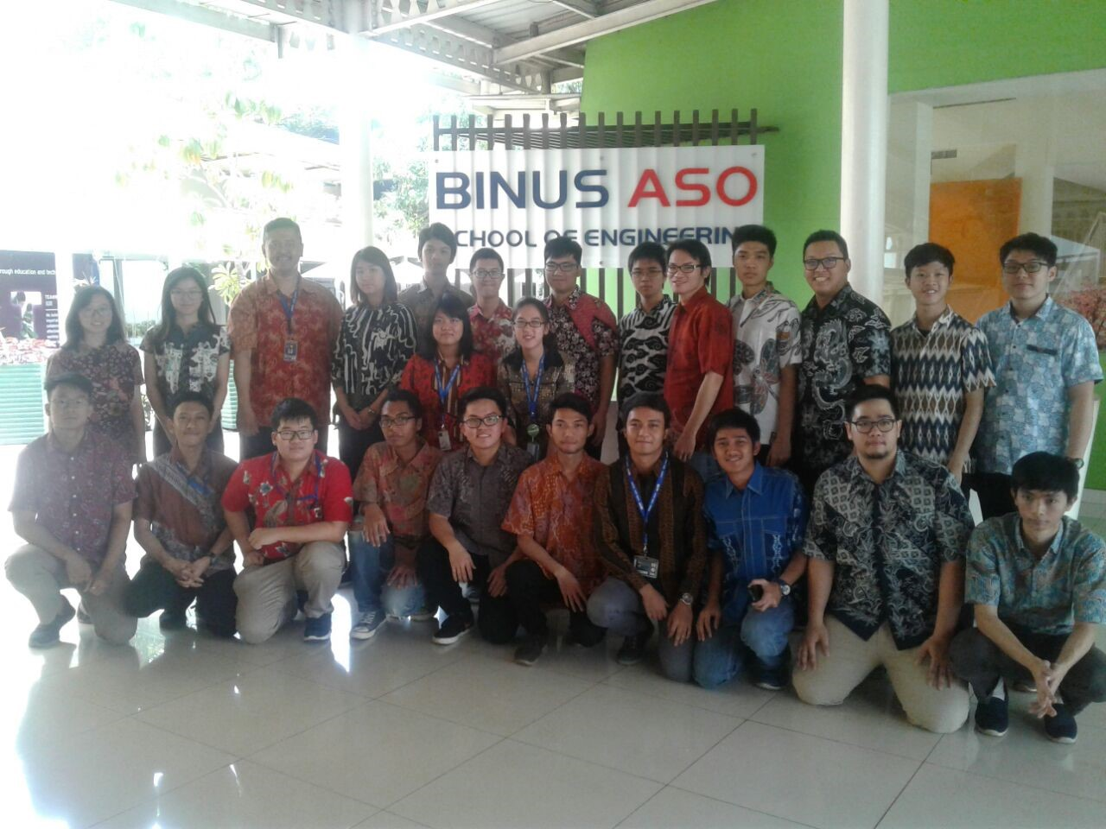
Bina Nusantara University (Binus), Indonesia

Slide 17
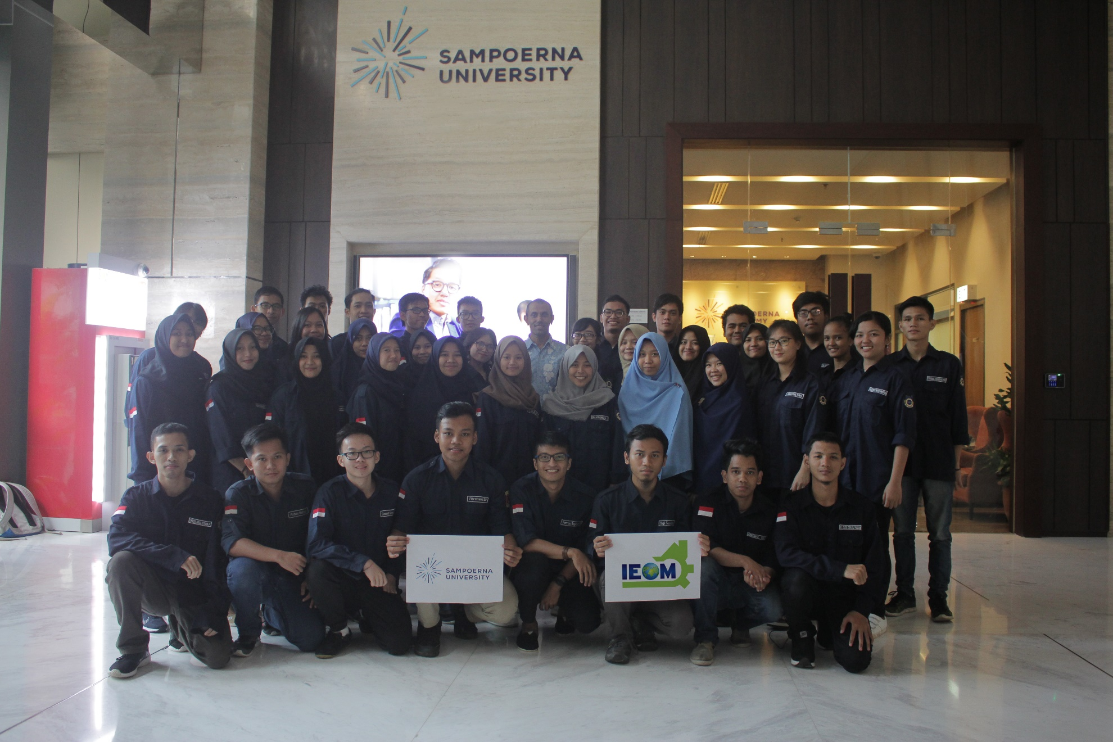
Sampoerna University, Jakarta

Slide 18
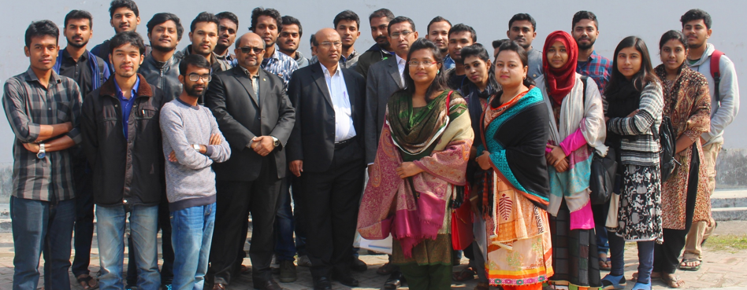
Khulna University, Bangladesh

Slide 19
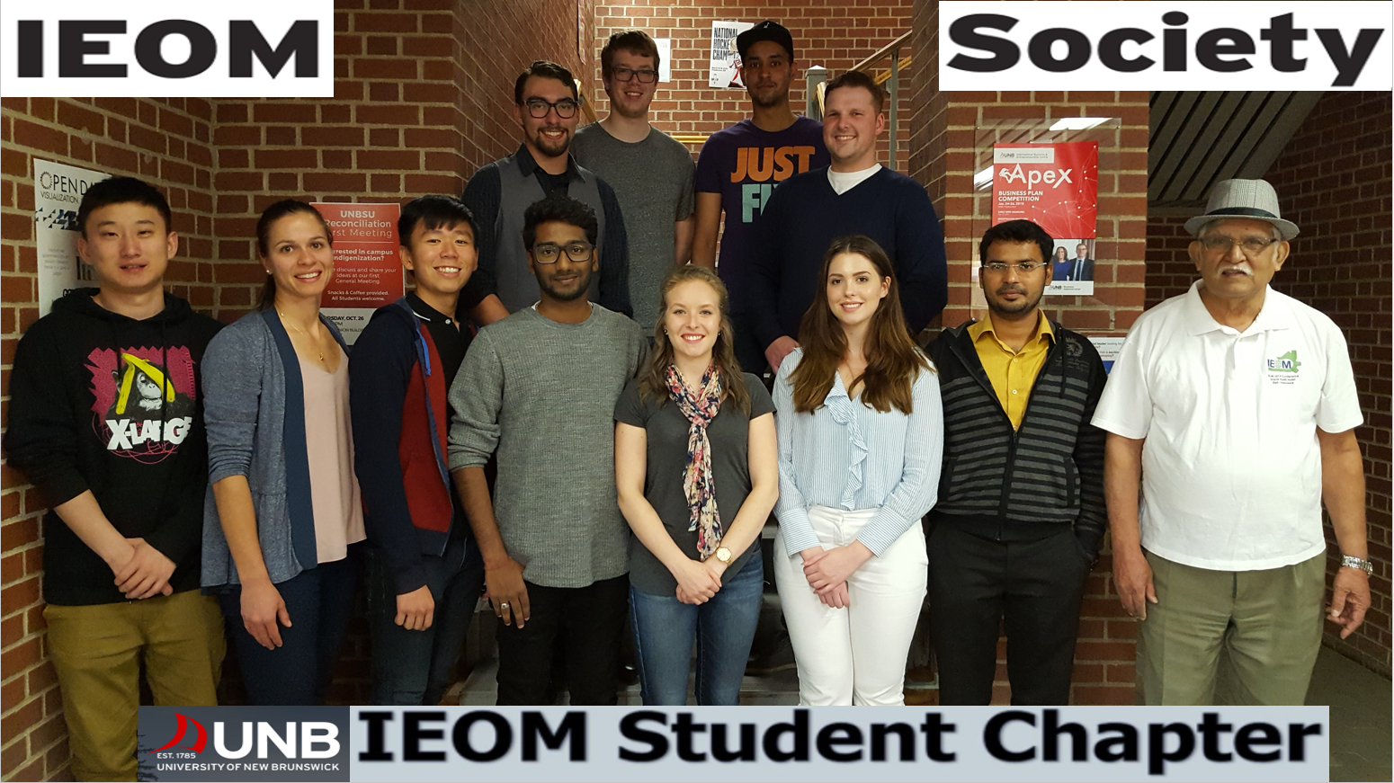
University of New Brunswick at Fredericton

Slide 20
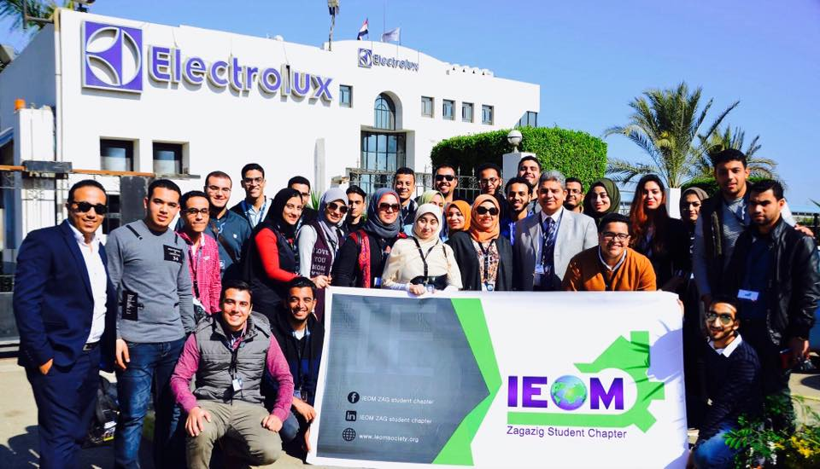
Zagazig University, Egypt

Slide 21
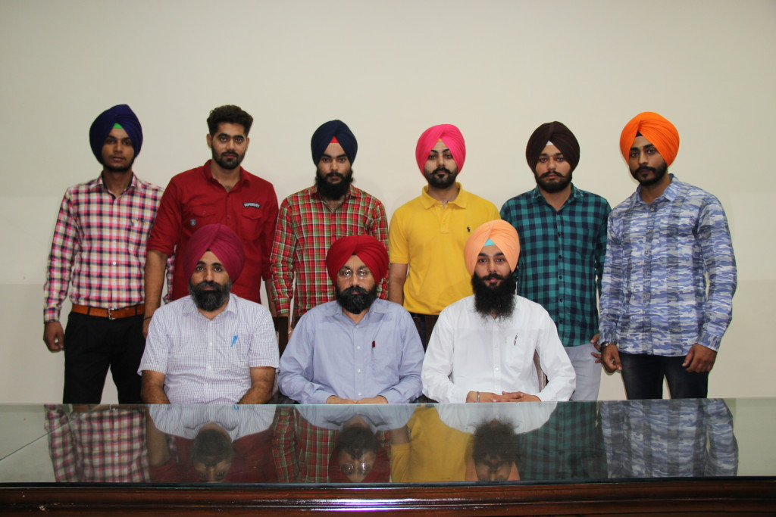
Guru Nanak Dev Engineering College, Ludhiana, Punjab, India

Slide 22
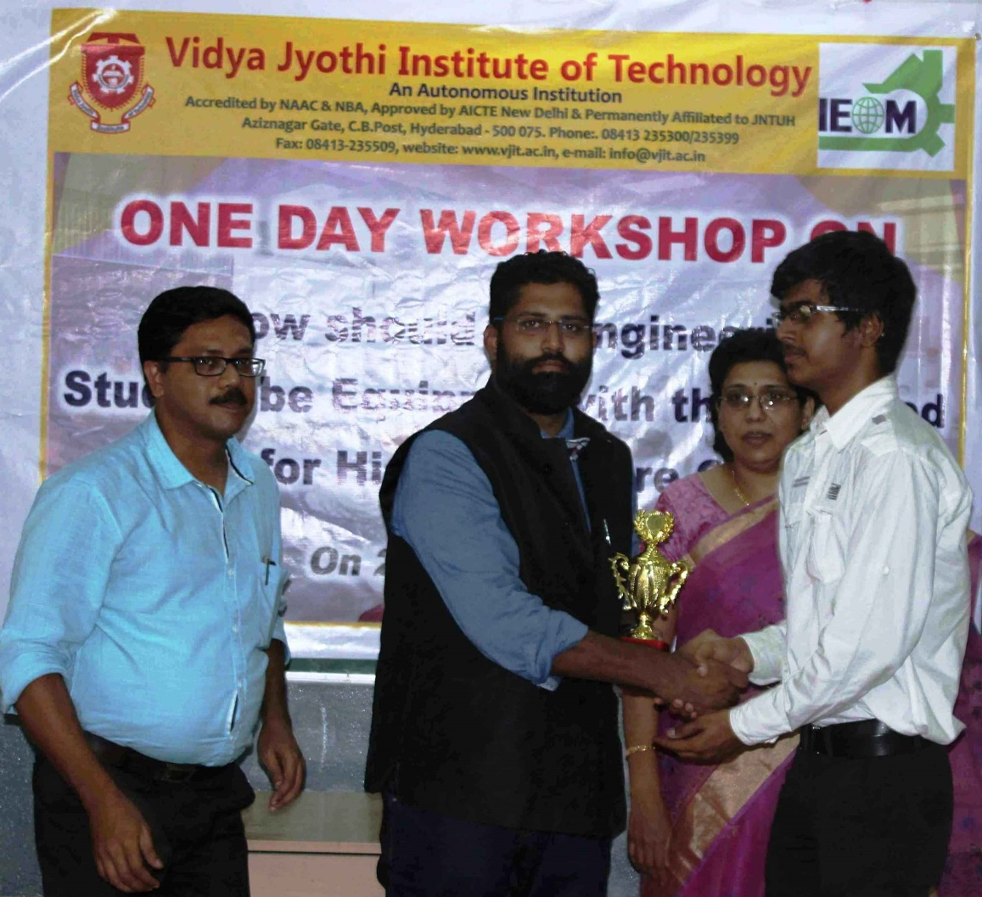
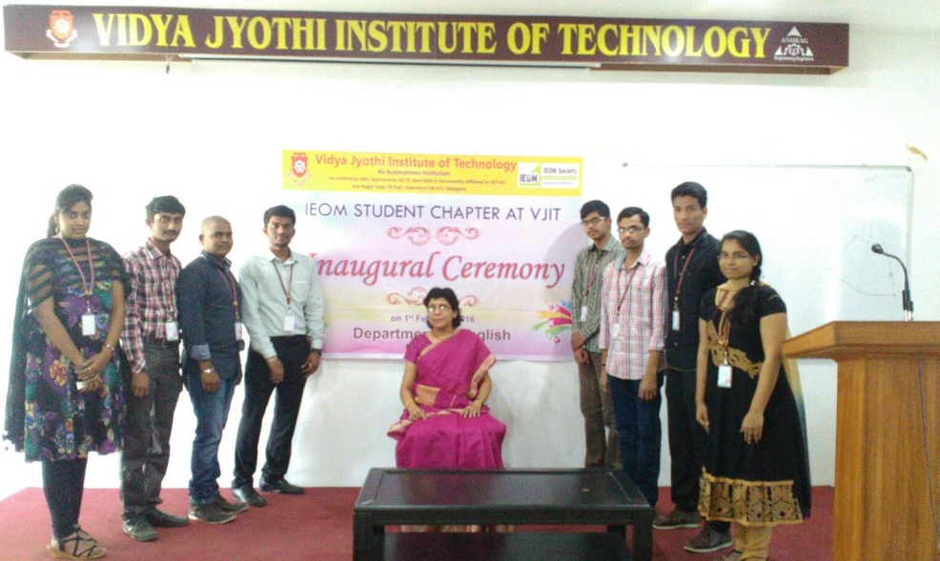
Vidya Jyothi Institute of Technology, Hyderabad

Slide 23
UTHM, Malaysia

Slide 24
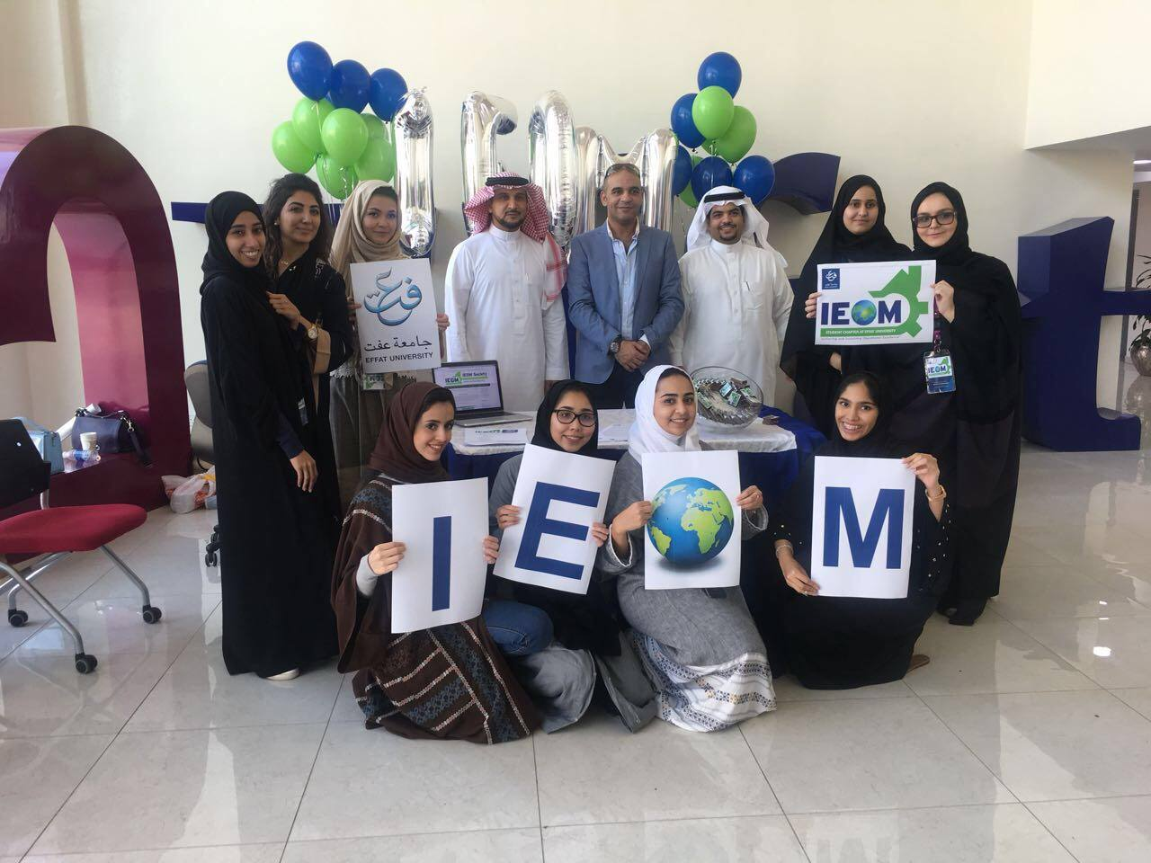
Effat University, Jeddah, Saudi Arabia

Slide 25
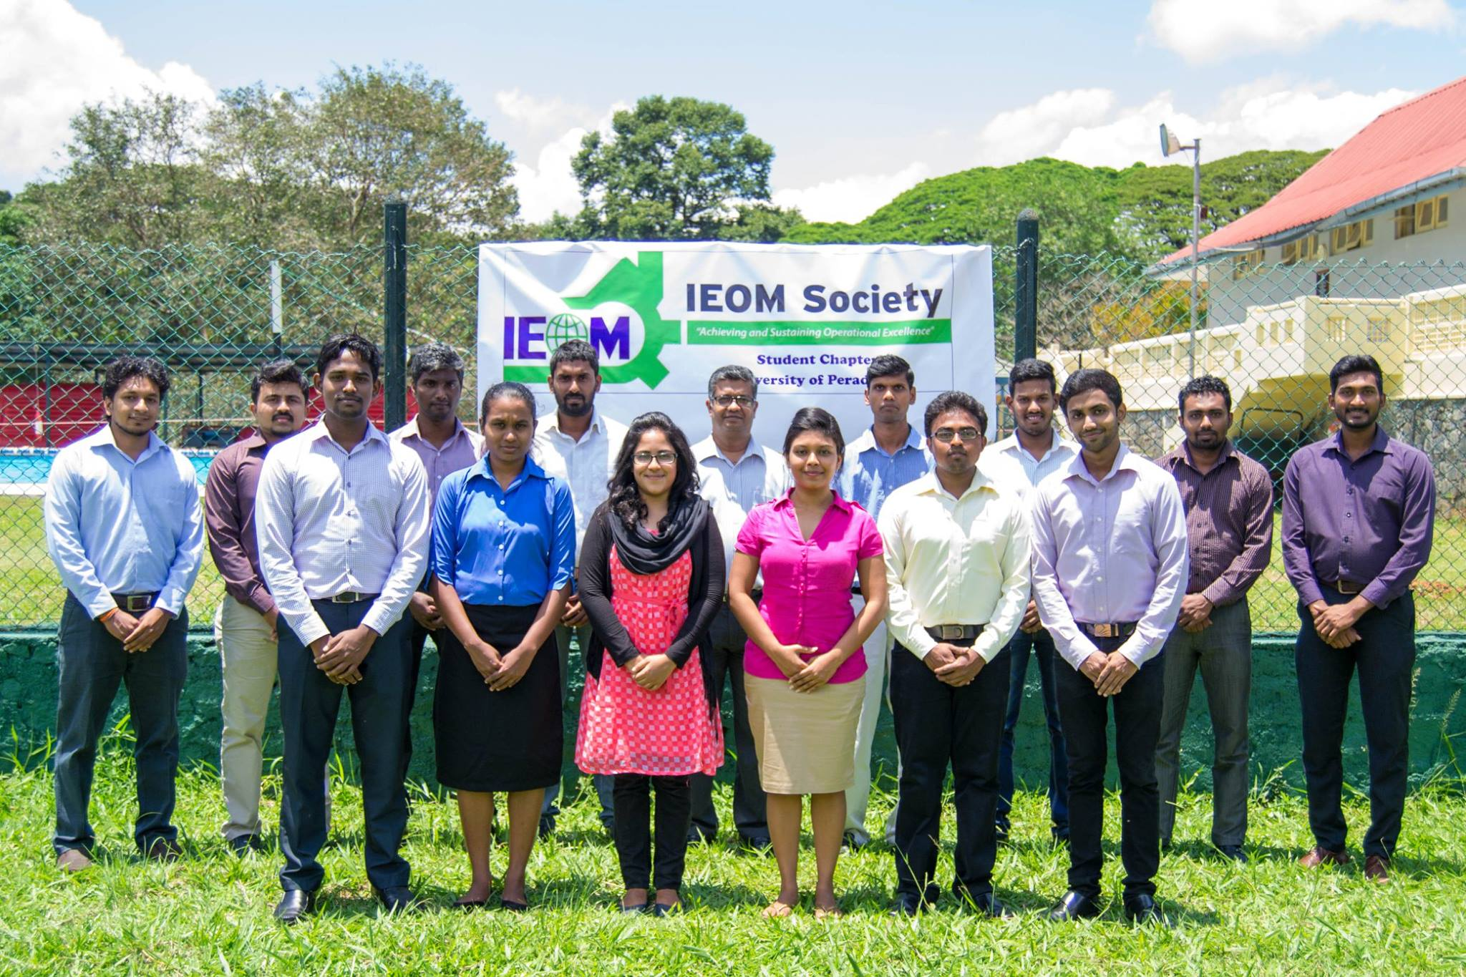
University of Peradeniya, Sri Lanka

Slide 26
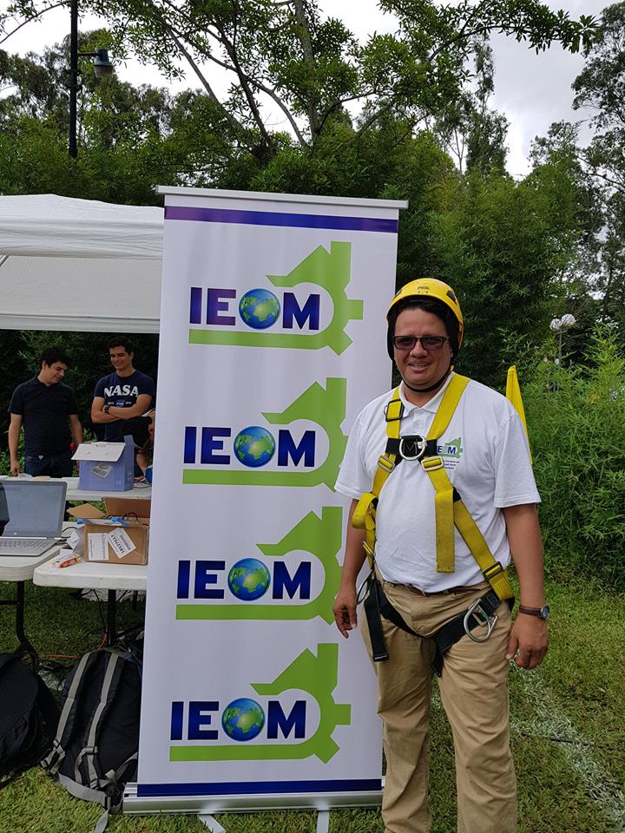
University of Costa Rica

Slide 27
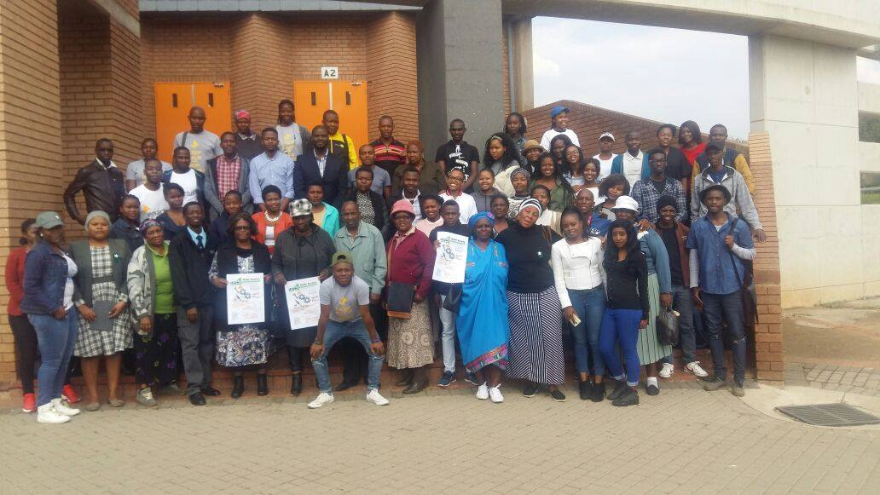
University of Johannesburg, South Africa

Slide 28
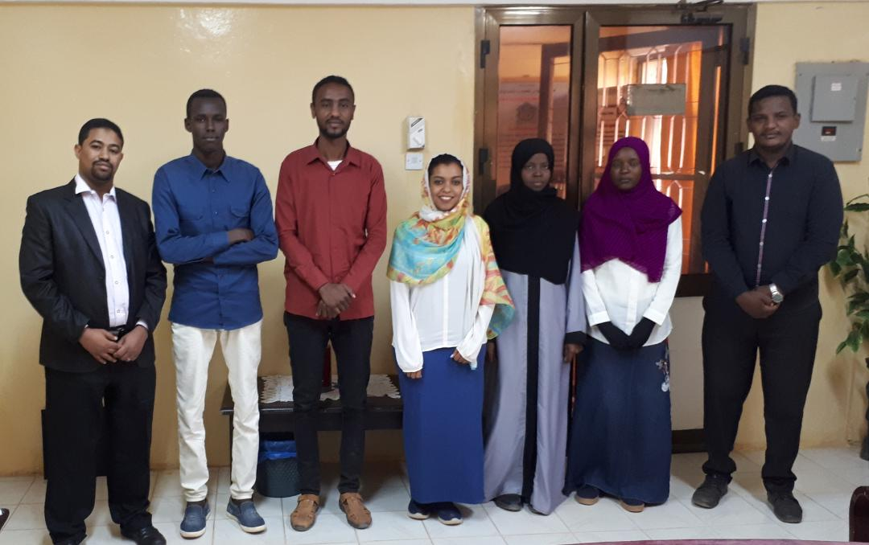
Sudan University of Science and Technology

Slide 29
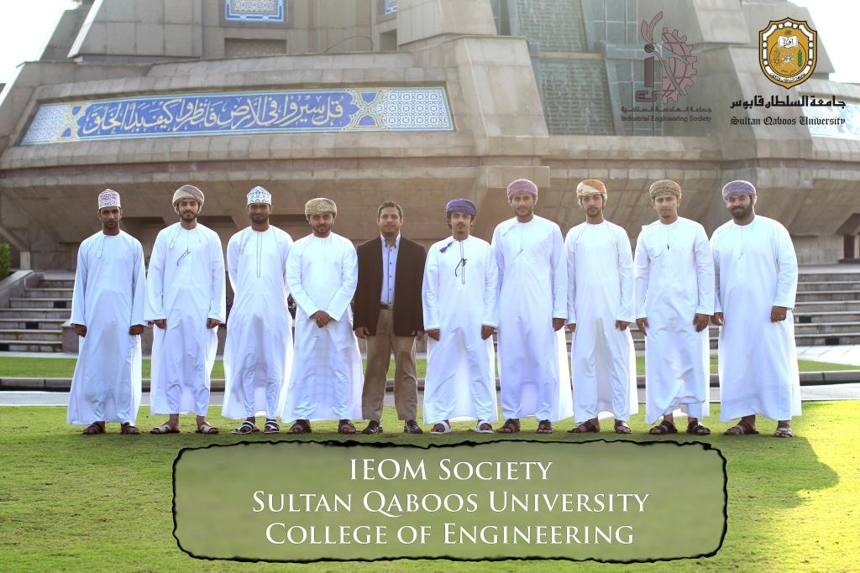
Sultan Qaboos University, Oman

Slide 30
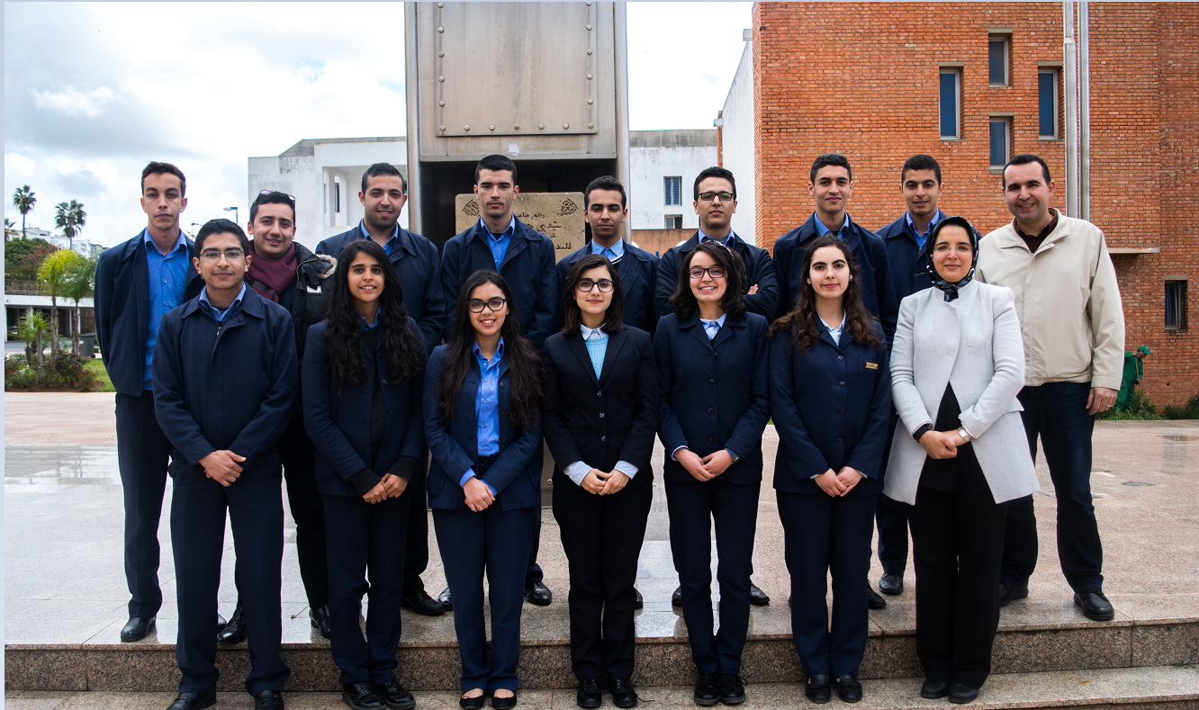
Ecole Mohammadia d’Ingénieurs (EMI), Rabat, Morocco

Slide 31
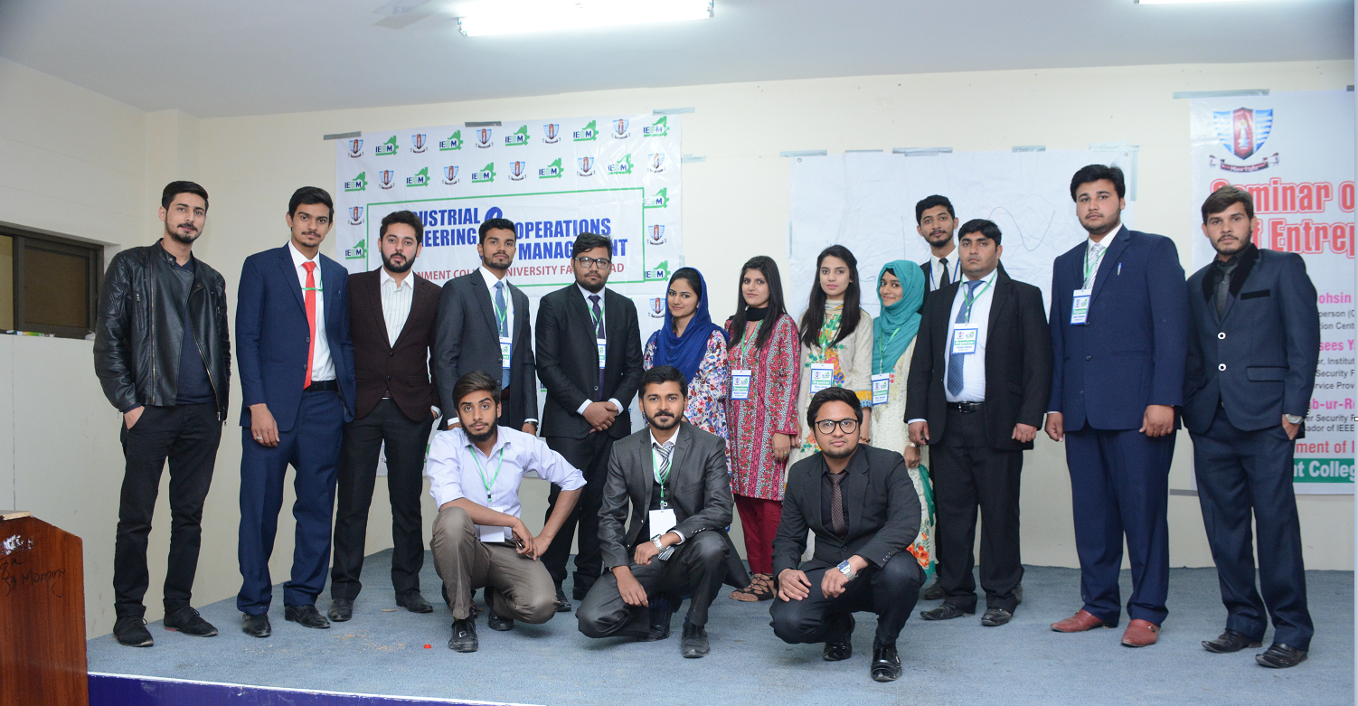
Govt. College University Faisalabad, Pakistan

Slide 32
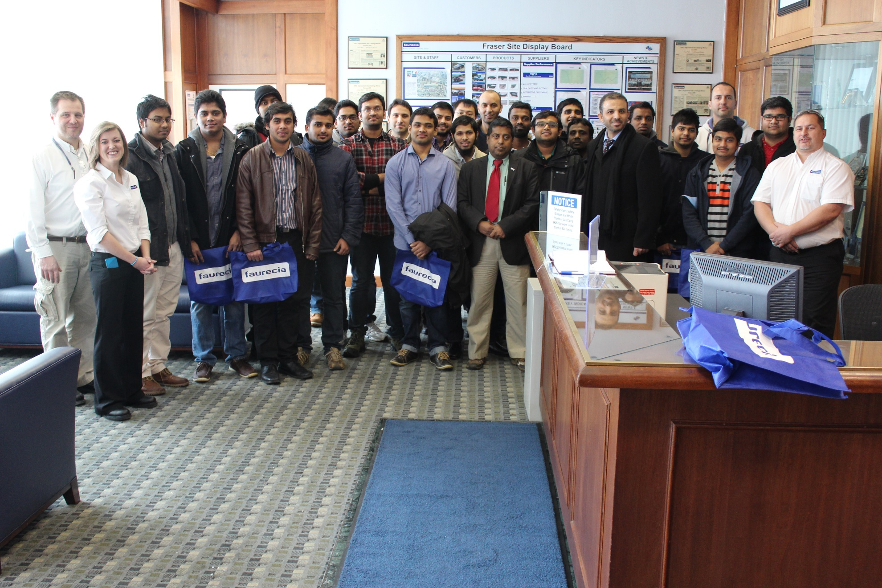
Lawrence Technological University, Michigan, USA

Slide 33
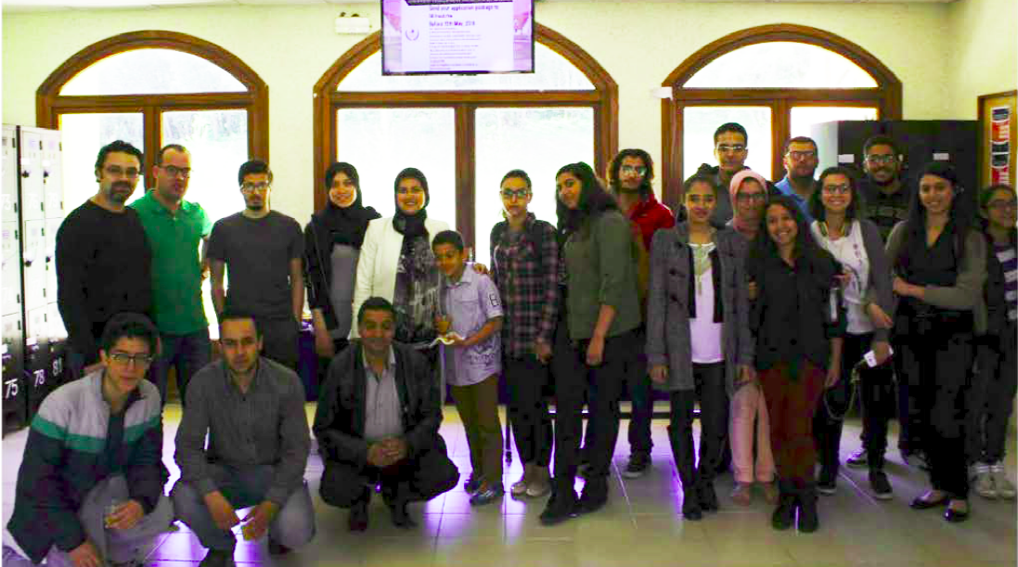
Al Akhawayn University, Ifrane, Morocco

Slide 34
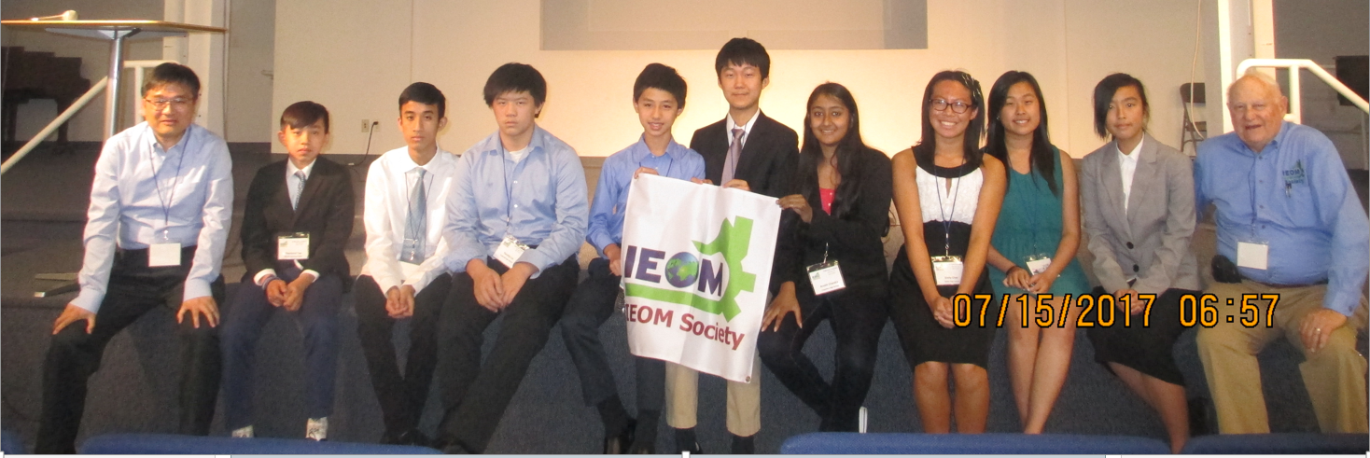
Bay Area Middle School & High School Student Chapter - San Jose, CA

Slide 35
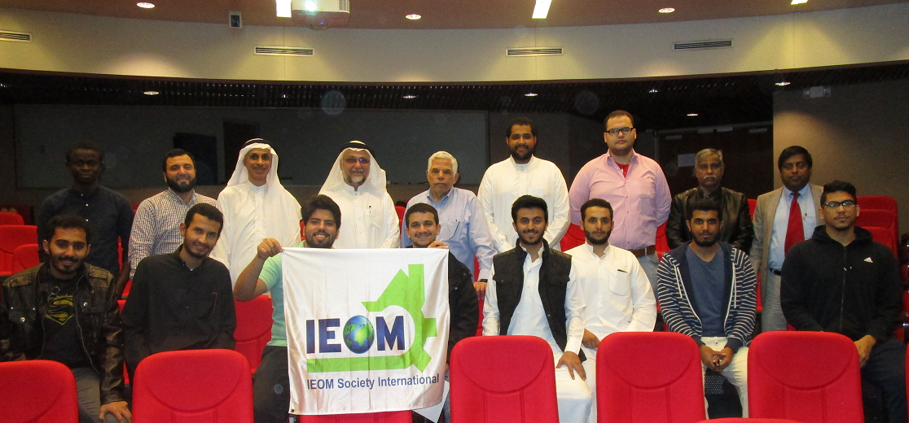
King Fahd University of Petroleum and Minerals (KFUPM)

Slide 36
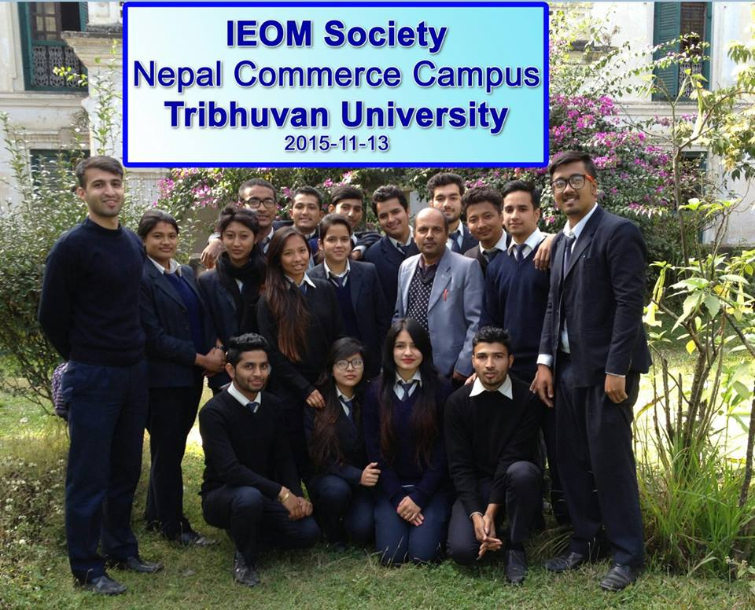

Slide 37
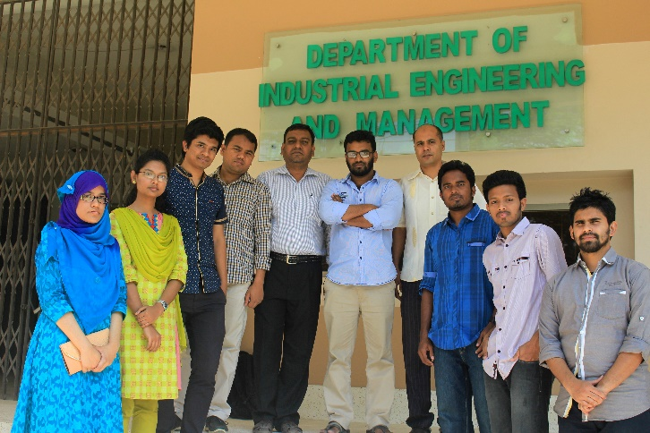
Khulna University of Engineering and Technology, Bangladesh

Slide 38
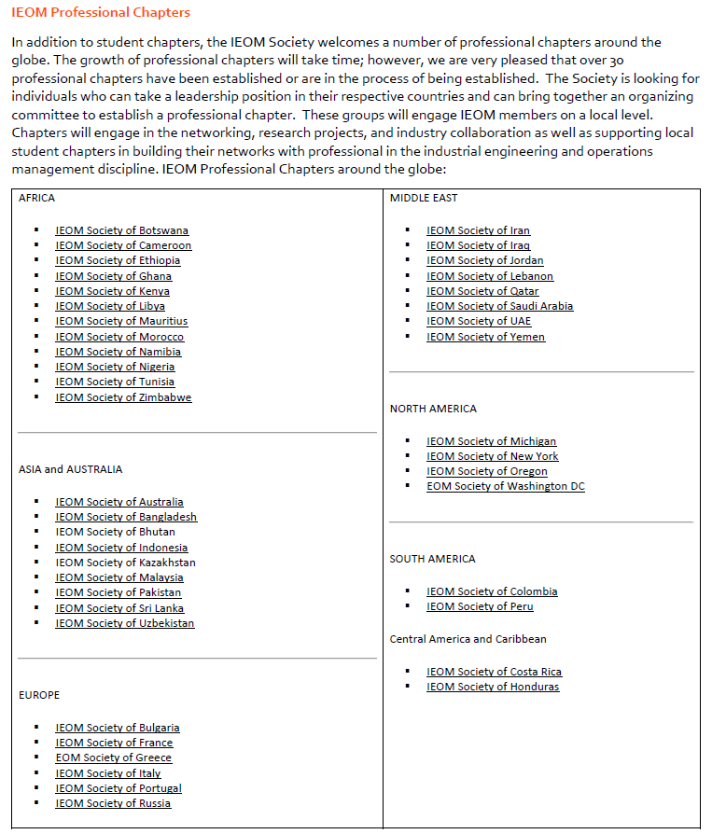

Slide 39
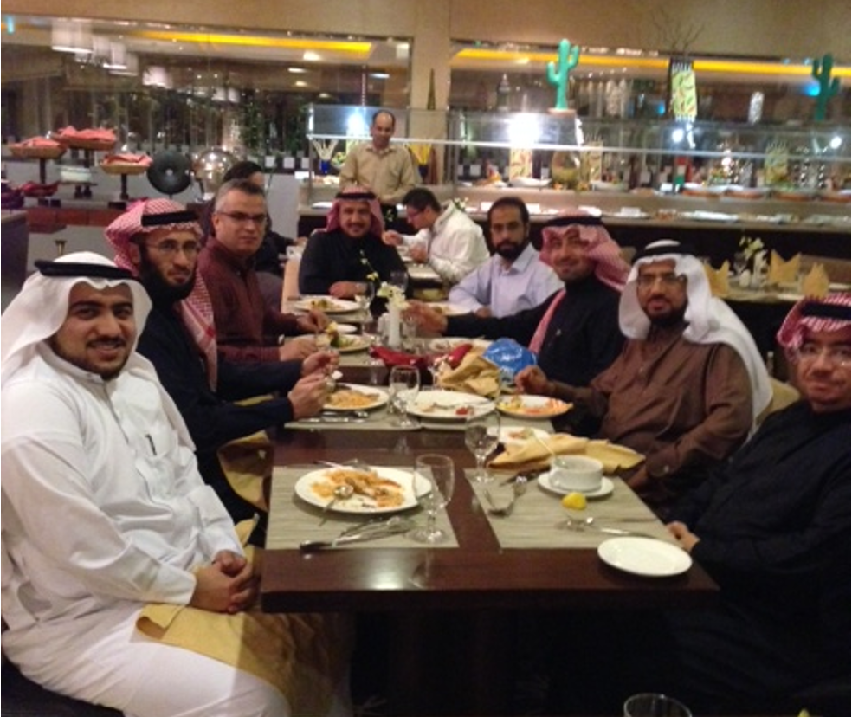
Meeting was held at EPD (Environmental Production Department), Engineering Services of Saudi Aramco

Slide 40
Competitions
IEOM Undergraduate Student Paper Competition Sponsored by SIEMENS
IEOM Graduate Student Paper Competition Sponsored by EATON Corporation
Doctoral Dissertation Competition
Final Year Project (FYP)/Senior Capstone Design Project Poster Competition
Undergraduate Research Competition
High School and Middle School (K-12) STEM Competition
Masters’ Thesis Competition
Simulation and PLM Competition
Best Poster Award Competition
www.ieomsociety.org

Slide 41
IEOM Publication
IJIEOM
Editor-in-Chief
Prof. Jose Arturo Garza-Reyes
Professor of Operations Management
Head of the Centre for Supply Chain Improvement
College of Business, Law and Social Sciences
The University of Derby
Derby, UK
Online Proceedings – Scopus Indexing
www.ieomsociety.org

Slide 42
Membership
Membership:
Professional
Student
Associate
University Partners
Corporate Partners
Organization Partners
www.ieomsociety.org

Slide 43
Awards
IEOM Fellows (Academy of IEOM Fellows)
IEOM Global Diversity Awards
IEOM Innovation Awards
IEOM Global Manufacturing Awards
IEOM STEM Awards
IEOM Distinguished Educator Awards
IEOM Distinguished Industry Awards
IEOM Distinguished Service Awards
IEOM Outstanding Researcher Awards
IEOM Outstanding Teaching Awards
IEOM Industry Solutions Awards
IEOM Global Engineering Education Awards
IEOM Woman in Industry and Academia (WIIA) Awards
Outstanding Service Awards
Outstanding Student Awards
www.ieomsociety.org

Slide 44
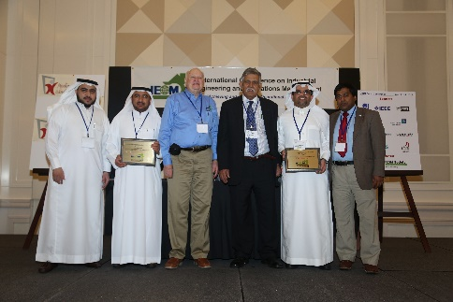
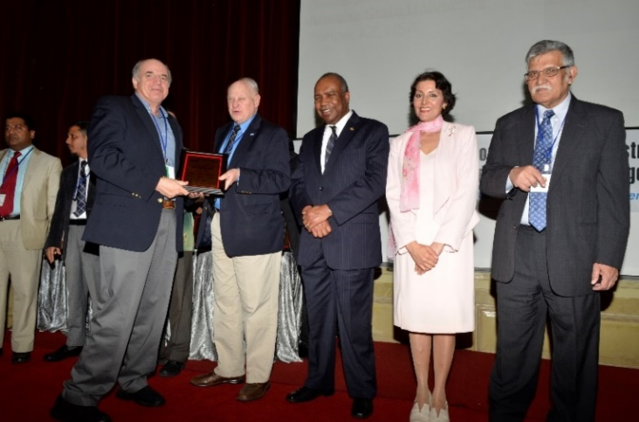
Awards
www.ieomsociety.org

Slide 45
Forums
Global Engineering Education
Industry Solutions
Women in Industry and Academia (WIIA)
www.ieomsociety.org

Slide 46
Media
Newsletters
LinkedIn
Facebook Group
Website
www.ieomsociety.org

Slide 47
Technical Groups
Artificial Intelligence
Cyber Security
Data Analytics
Defense and Aerospace
Engineering Management
Entrepreneurship, Innovation and Sustainability
Healthcare Systems and Management
Human Factors and Ergonomics
Information Technology and Quality Assurance
Invertor Management and Production Planning
Lean Systems Manufacturing and Design
Operations Research and Operations Management
Project Management
Quality and Reliability
Simulation and Modeling
Six Sigma
Supply Chain and Logistics
Sustainability and Green Systems
Systems Engineering
Technology Management
Total Quality Management
Transportation and Construction Management
www.ieomsociety.org

Slide 48
Certification and Standards
Certification
Lean Six Sigma Green Belt (LSSGB)
FMEA
GD&T
Supply Chain Certification (SCC)
IEOM
IEOM Standards – Industry Consortiums
www.ieomsociety.org

Slide 50
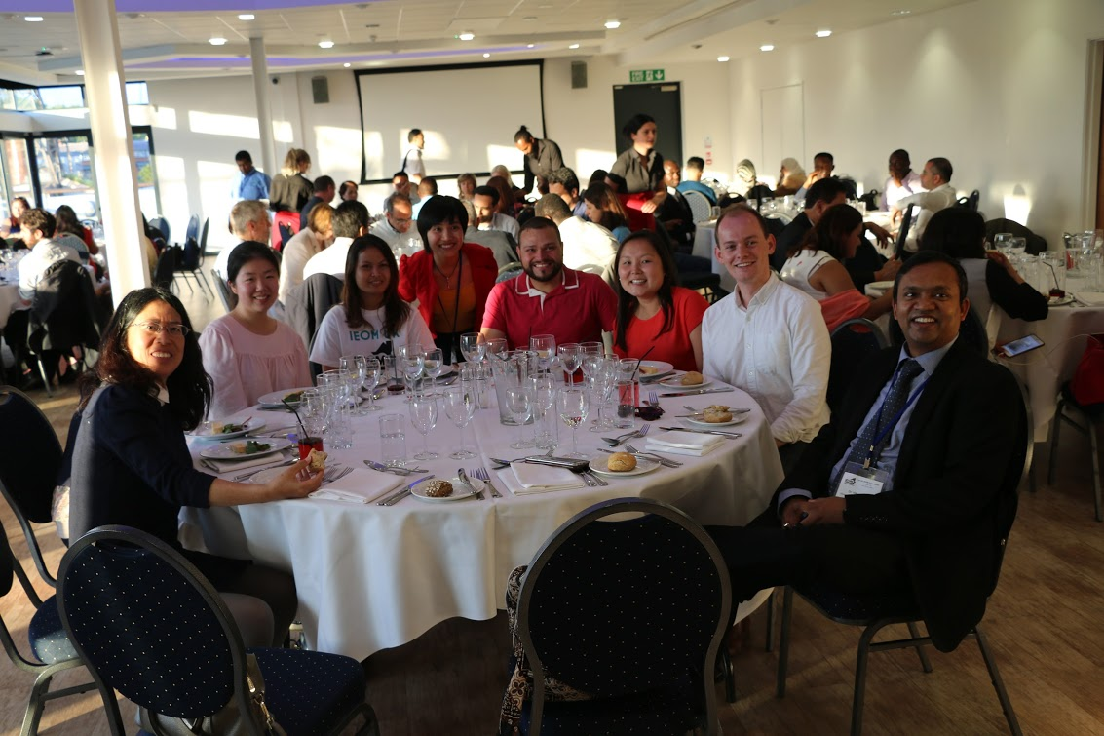
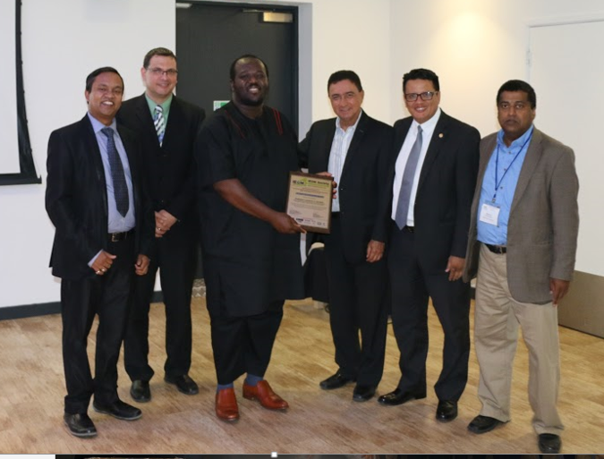

Slide 53
2017 Bogota Conference

Slide 55
IEOM 2017 Morocco

Slide 57
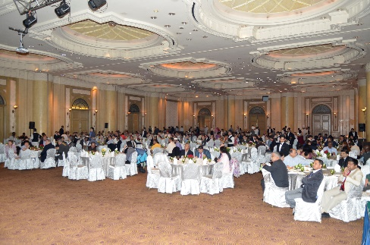
IEOM Malaysia 2016

Slide 59
2016 IEOM Detroit

Slide 61
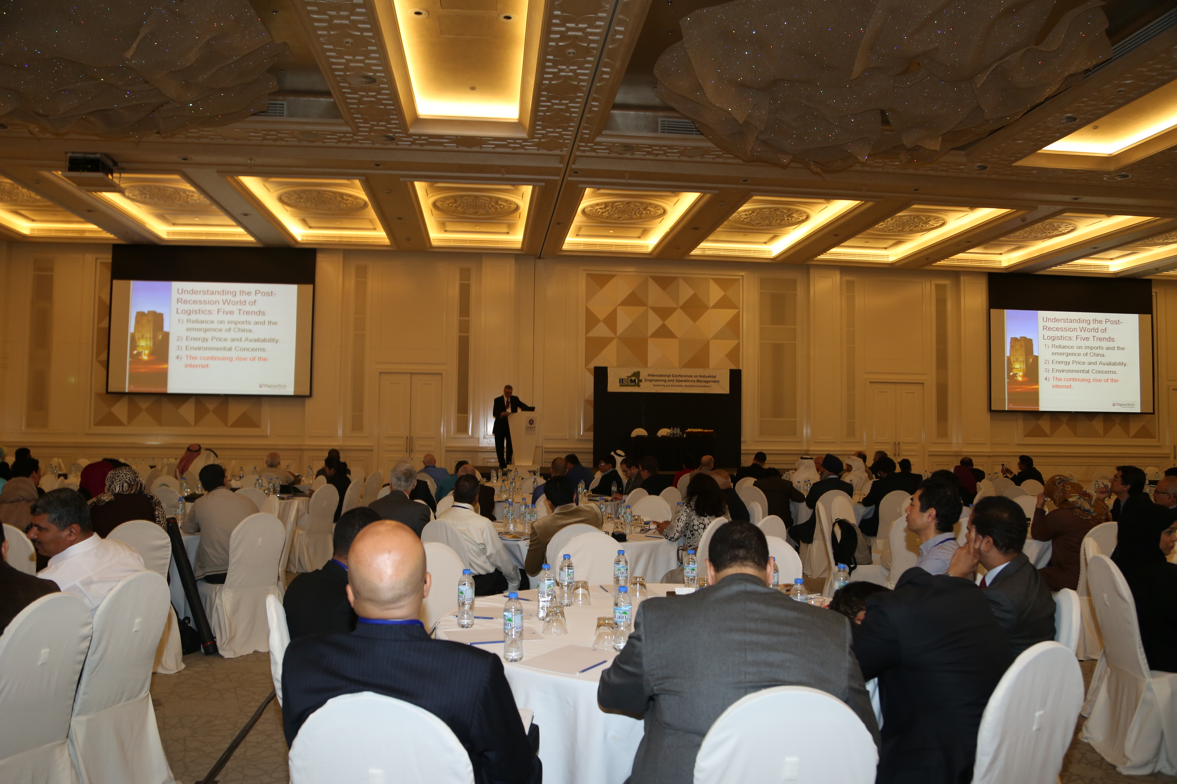

Slide 65
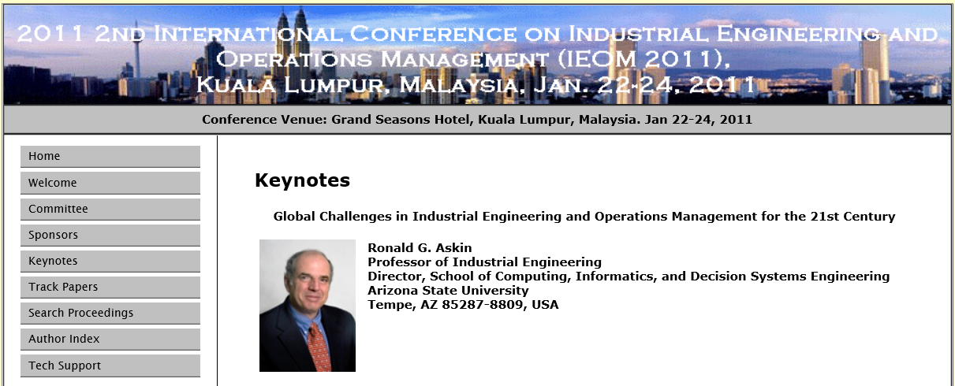
IEOM 2012 Malaysia
www.ieomsociety.org

Slide 66
IEOM 2010 Dhaka
www.ieomsociety.org

Slide 67
Establishing Your Student Chapter
Hold an organizational meeting with faculty advisor and students
Review and discuss the IEOM chapter organizational process
Complete and submit application to the IEOM Society.
Receive Charter Certificate from the IEOM Society
www.ieomsociety.org

Slide 68
Benefits
Establishing Your Student Chapter
Be part of the diverse IE and OM professionals
Leadership and Team Building
Communications
Organization Management
Skill Enhancement
Applied IE & OM Tools and Techniques
Professional Development
Access IEOM publications
Webinar
IEOM Newsletters
Access IEOM Online Resources
Networking Opportunities
Conferences, Seminars and Workshops
Career Development
Free IEOM Email
Virtual Global Design Competition
Certifications
www.ieomsociety.org

Slide 69
Suggested Chapter Activities
Industry Visits
Seminars and Workshops
Publications / Newsletters
Poster / Innovation Competitions
Paper Competitions
Senior Design Poster Competition
Design Competition
Alumni Night
Industry Speakers
Networking Event
www.ieomsociety.org

Slide 70
FACULTY ADVISOR
Faculty member serves as the champion in establishing a IEOM Society student chapter at your university.
This faculty will also serve as a faculty advisor and guide the chapter in its development.
www.ieomsociety.org

Slide 71
Suggested IEOM CHAPTER OFFICERS
President
Vice President
Secretary
Treasure
Director of Membership
Director of Programs / Activities
Director of Social Media
Director of Communication
Director of Newsletter and Publication
www.ieomsociety.org

Slide 72
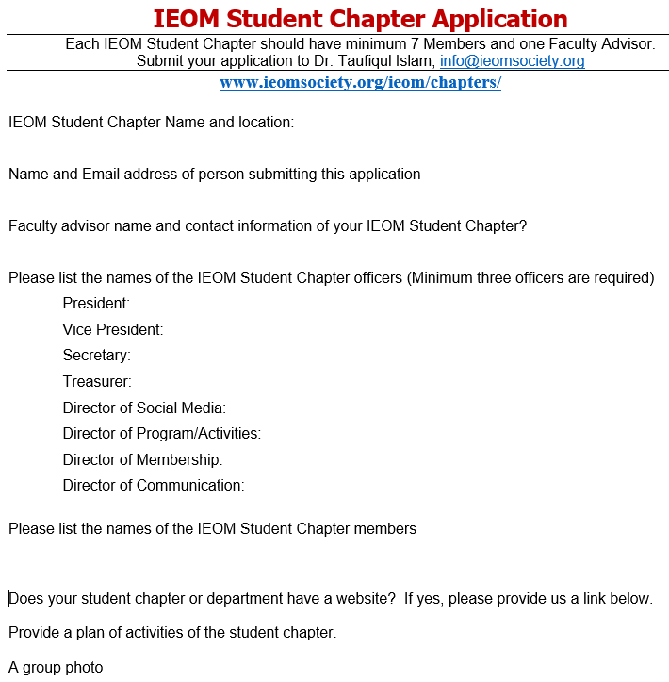

Slide 74
Student Portfolio Development
Excellent Academic Record (GPA)
Software Skills and Certifications
IELTS / TOEFL Score
GRE
English Speaking / Project Presentation / Presentation Skill
Communications – written, oral and graphical
Student Organization Membership and involvement, student chapter officers, initiatives, etc.
Attend seminar, workshop, symposiums, etc.
Presentation at any events
Poster competition / innovation competition
Leading a team, organizing an event, team participation
Networking
Publications: Conference paper, journal paper, magazine article, newspaper article, etc.

Slide 75
THANK YOU
Professor Don Reimer Director of Chapter Development
Email: info@ieomsociety.org
IEOM Society International
21415 Civic Center Dr., Suite # 217
Southfield, Michigan 48076, USA

